Slide 1

Ahmed Makled
Flutter Mobile Application Developer
Building scalable, high-performance cross-platform mobile apps.

Slide 2
About My Journey
I’m a professional Flutter Mobile Developer specialized in building high-quality Android applications using Flutter, Firebase, and REST APIs.
I chose mobile development to deliver reliable, real-world solutions through well-structured and maintainable apps.
I continuously develop my skills by staying up to date with best practices and applying them in real-world mobile applications.
So far, I’ve built and maintained 100+ screens and 10+ production-ready applications from concept to deployment.
I work with startups, individuals, and small teams to deliver scalable, user-friendly mobile solutions.
I’m known for strong attention to detail, clean architecture, and a commitment to long-term code quality.
Looking for a dependable Flutter developer? Let’s connect.

Slide 3
Education
2022 – 2026: B.Sc. of Information Technology from Computer Science & Artificial Intelligence FCAI Damietta University

Slide 4
Core Skills
Tools
Flutter & Dart development
State Management: Provider, Bloc
Clean Architecture
Android app development
Responsive & adaptive UI design
Performance optimization
REST API integration
Firebase: Authentication, Firestore
Git / GitHub
VS Code / Android Studio
Postman
SQLite, Hive, SharedPreferences
JSON serialization / parsing

Slide 5
Soft Skills for Success
Problem-Solving: Analytical approach to identify and resolve complex development challenges.
Communication: Clear and effective interaction with clients and team members.
Time Management: Efficiently handling multiple tasks and meeting project deadlines.
Rapid Learning: Quick adaptation to new technologies and evolving industry standards.
Teamwork/Independence: Ability to thrive in both collaborative and autonomous environments.
Adaptability: Flexible and responsive to project changes and client feedback.

Slide 6
Work Experience & Internship
Digital Egypt Pioneers Initiative (DEPI) – Cross-Platform Mobile App Development Ministry of Communications and Information Technology | 07/2025 – Present
Invested 6 months in a structured, hands-on program focused on full-cycle mobile app development.
Designed and developed comprehensive graduation project implementing complex UI and robust functionality.
Applied Flutter, Firebase, REST APIs, and state management solutions to build scalable, maintainable applications.
Gained strong exposure to clean code principles, app architecture, and performance optimization.
Improved professional workflow using version control, debugging, and testing techniques.
Strengthened experience in integrating APIs, local storage solutions, and Flutter-based UI/UX best practices.
National Telecommunication Institute (NTI) – Cross-Platform Mobile App Development Ministry of Communications and Information Technology | 02/2026
Invested 120+ hours in intensive practical training, focusing on advanced mobile development concepts.
Practiced and implemented Clean Architecture principles, modular code, and scalable app design patterns.
Help identify and resolve technical issues as they arise during development.
Applied Flutter, Firebase, REST APIs, and state management solutions

Slide 7
Offered Services
Mobile UI/UX Design
Design original and visually appealing mobile interfaces.
Create interactive layouts and prototypes that focus on user experience.
State Management & Clean Architecture
Implement state management solutions (Provider, Bloc) with scalable architecture.
Develop maintainable applications focusing on performance and clean code principles.
UI/UX Implementation in Flutter
Implement your own designs directly in Flutter.
Convert Figma or Adobe XD designs into fully functional Flutter applications.
Performance Optimization & Debugging
Optimize app speed and overall performance.
Debug and monitor apps using Flutter DevTools and profiling techniques.
Backend Integration & API Development
Integrate REST APIs or Firebase backend into the app.
Handle real-time data, local storage (Hive, SQLite, SharedPreferences), and cloud sync.
Testing & Deployment
Perform Unit, Widget, and Integration testing.
Deploy apps to Google Play Store

Slide 8
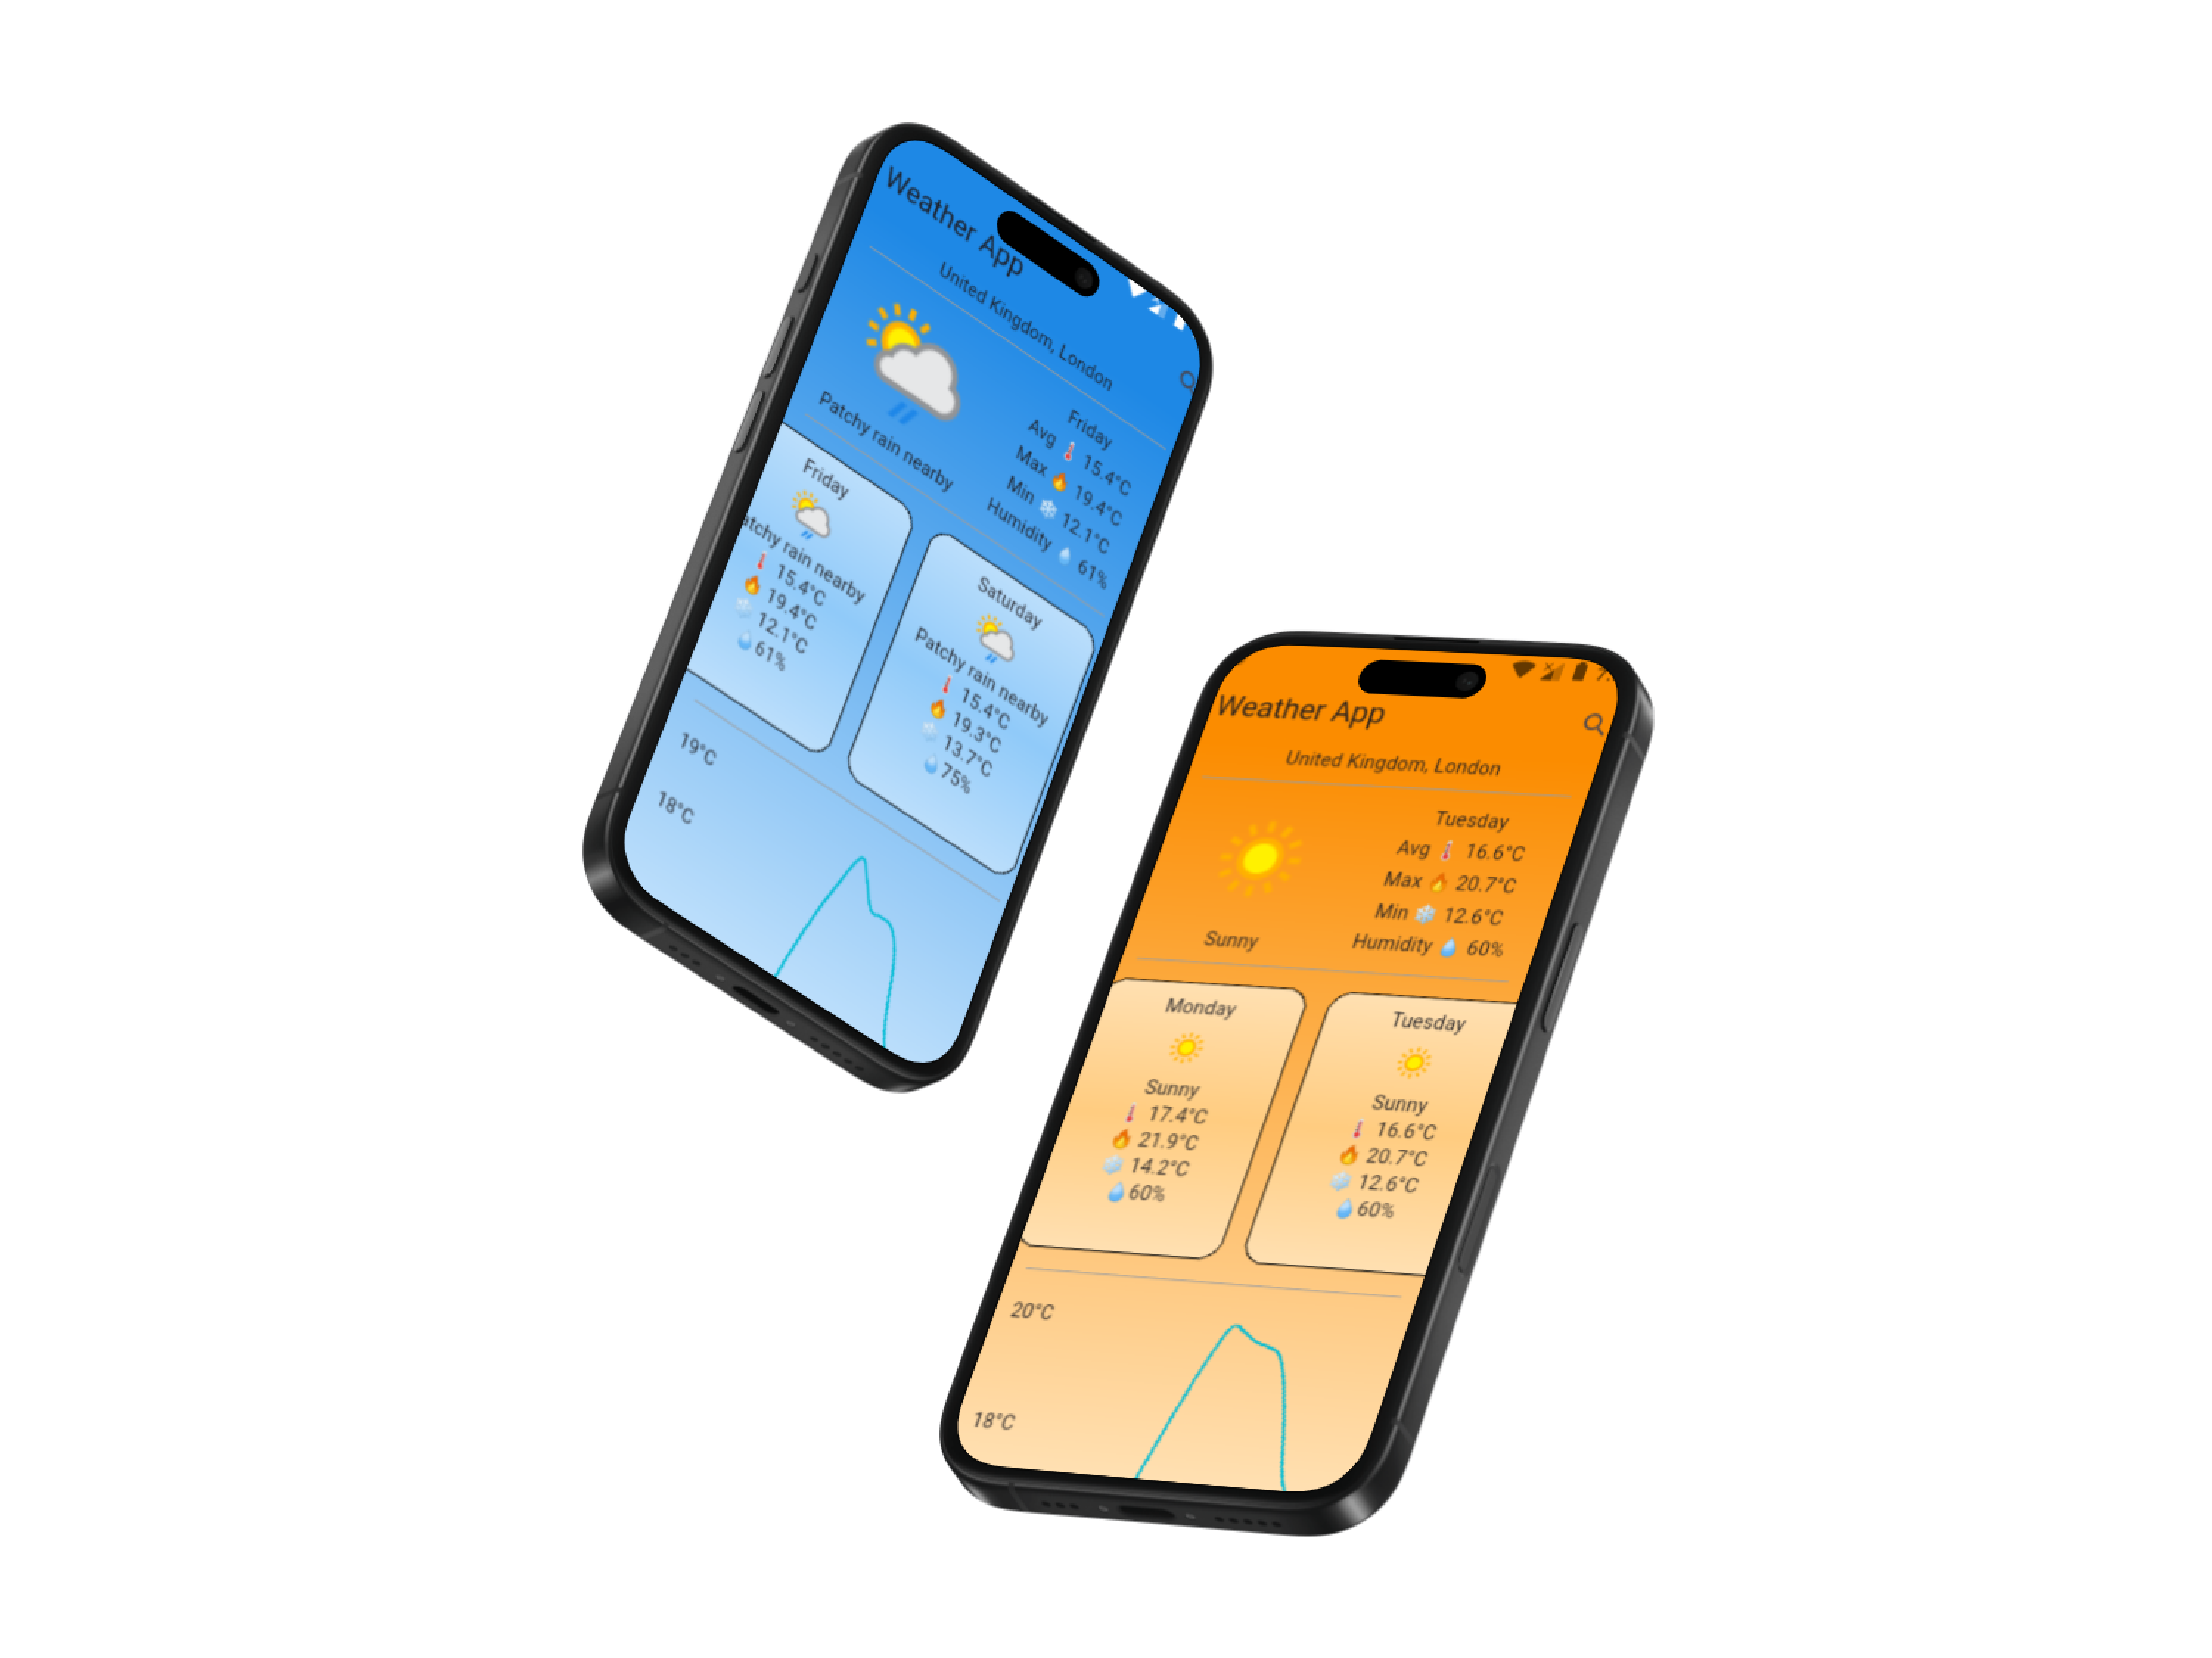
Professional Weather App
Project Description
A professional weather application built with Flutter that allows users to check the weather for any city in the world accurately and easily.
Key Features:
Search for any city worldwide and view current weather conditions.
Display a 7-day weather forecast with temperature, humidity, and weather descriptions.
Attractive, clean, and responsive user interface supporting both Arabic and English.
Weather icons and images for easy navigation and visual clarity.
High performance and smooth user experience across devices.
Technologies & Tools:
Flutter & Dart for cross-platform development
APIs for real-time weather data integration
State management using Provider for scalable architecture
Highlights:
Designed and implemented the entire UI/UX for a smooth, interactive experience.
Focused on clean, maintainable code and optimized performance.
Gained practical experience in API integration, responsive design, and localization.

Slide 9
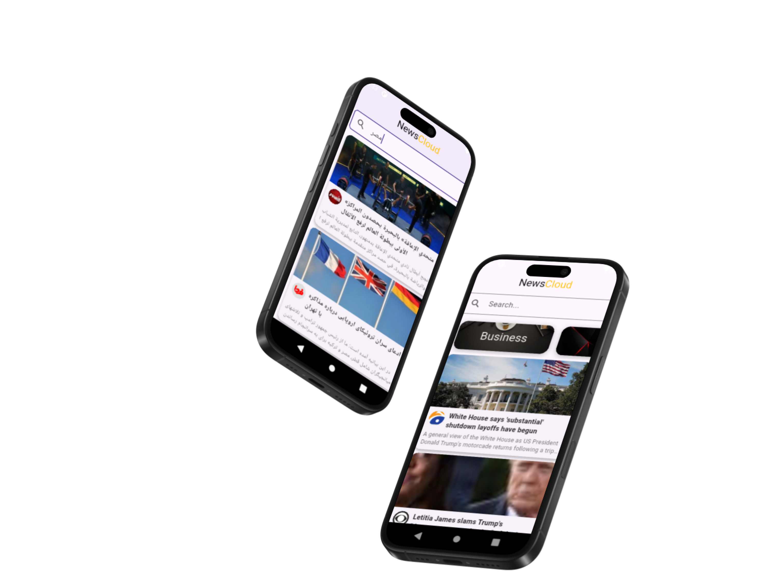
Professional News App
Project Description
A smart mobile application built with Flutter that allows users to follow the latest news from multiple sources in one place, with quick search and easy access to any topic.
Key Features:
Display the latest news from various websites in a clean and user-friendly interface.
Advanced search functionality to find news by title or keywords.
Open news articles directly within the app using a WebView, without leaving the application.
Browse news by source; tap on a source name to see all its articles.
Responsive and fast design providing a smooth user experience across devices.
Technologies & Tools:
Flutter & Dart for cross-platform development
APIs for fetching real-time news data
State management using Provider for scalable architecture
WebView integration for in-app news viewing

Slide 10
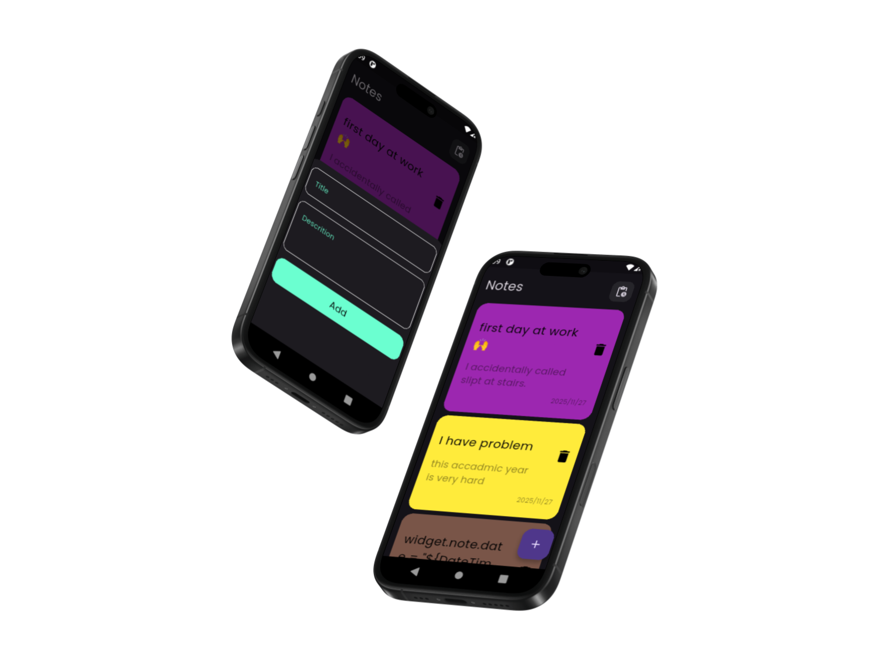
Professional Notes App
Project Description
A mobile application built with Flutter that allows users to create, manage, and organize their personal notes efficiently.
Key Features:
Add, edit, and delete notes with ease.
Organize notes by categories or tags for quick access.
Search functionality to find notes instantly.
User-friendly interface with a clean and minimal design.
Offline storage using Hive for secure and fast access.
Technologies & Tools:
Flutter & Dart for cross-platform development
Local database: Hive
State management using Provider for scalable architecture
Highlights:
Designed and implemented the entire UI/UX for a smooth user experience.
Focused on clean, maintainable code and high performance.
Gained hands-on experience with local storage, state management, and responsive design.

Slide 11
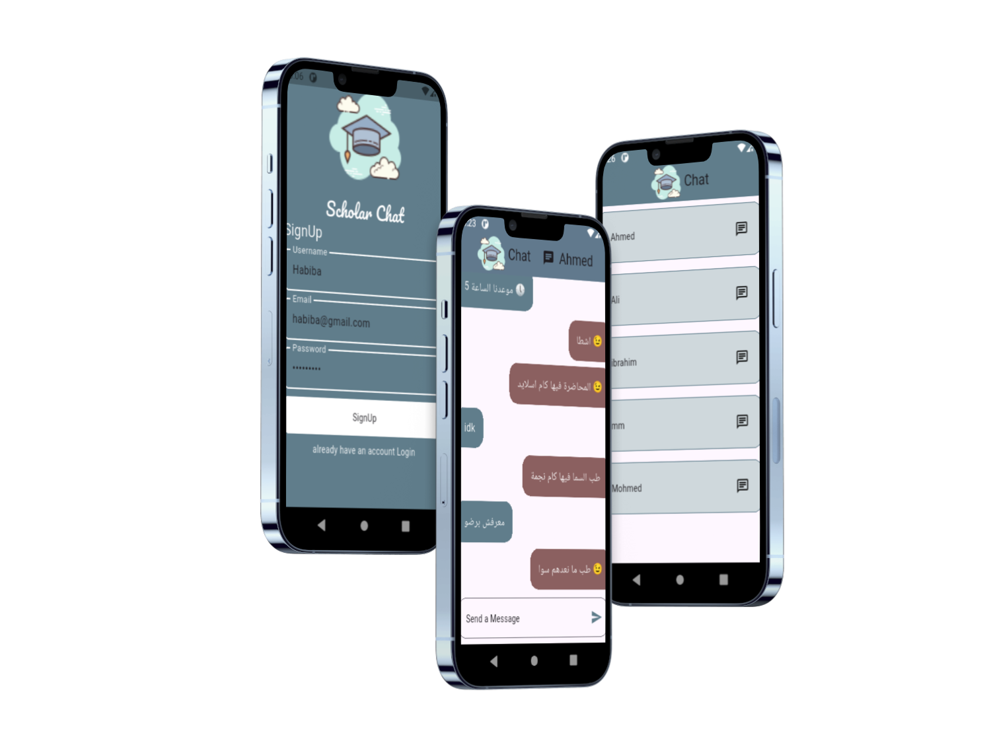
Professional Chat App
Project Description
A real-time chat application built with Flutter and Firebase for instant text messaging with a clean and user-friendly interface.
Key Features:
Sign up and log in using email accounts.
One-on-one chats with real-time messaging via Firebase Firestore.
Audio notifications for new messages.
Clean UI with chat bubbles and auto-scroll to the latest message.
High performance with smooth and responsive design across devices.
Technologies & Tools:
Flutter & Dart, Firebase Firestore, Firebase Authentication, AudioPlayers

Slide 12
Let's Build Together
Ready to transform your ideas into exceptional mobile experiences?
Contact Me
Connect Online
Phone: +201009269051
LinkedIn Profile
Email: ahmed1.makled1@gmail.com
GitHub Profile
Thank You!

